Slide 1
HY335b: Chapter 1 Class 3
Xenofontas Dimitropoulos
Credits: Jim Kurose & Keith Ross (for textbook slides)
Maria Keet & Kevin Webb (PI material)
Introduction
2-<number>

Slide 2
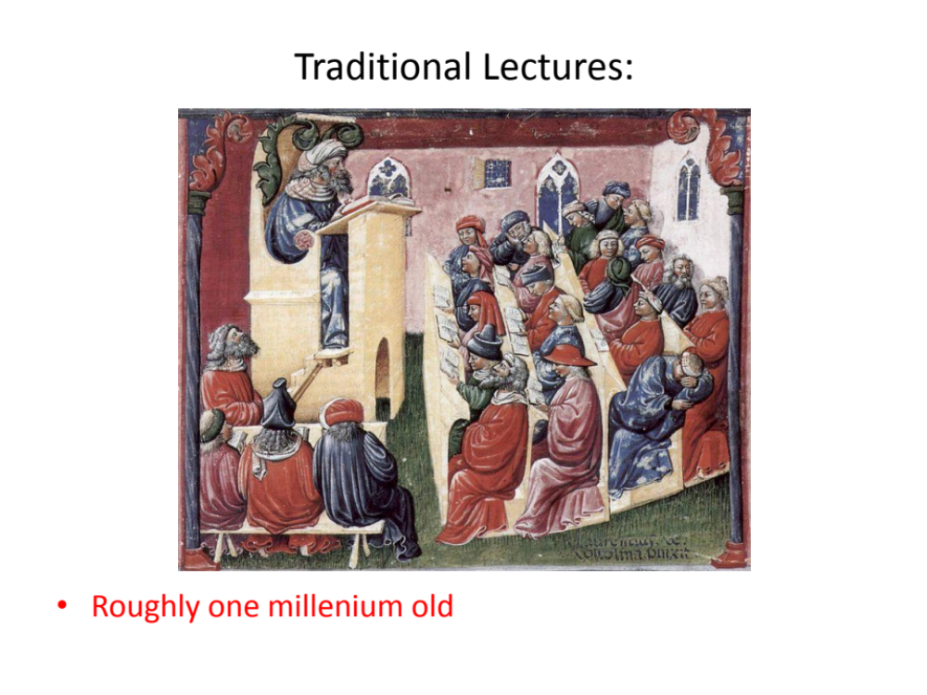
Introduction
2-<number>

Slide 3
Peer Instruction
During class: pose carefully designed questions
Solo vote: Think for yourself and select answer
Discuss: Analyze problem in teams
• Practice analyzing, talking about challenging concepts
Reach consensus
• If you have questions, raise your hand and I’ll come over
Group vote: Everyone in group votes
• You must all vote the same to get your point
Class wide discussion:
  Led by YOU (students) – tell us what you talked about in discussion that everyone should know!
Introduction
2-<number>

Slide 4
Which of the following is true of the Internet?
The internet is controlled by the world wide web consortium
The internet is a global network of computers linked to each other by transmission media
The internet is controlled by a few servers of multinational companies
The internet is synonymous to (the same as) the World Wide Web
The Internet is governed by the USA and monitored by the NSA
Introduction
1-<number>

Slide 5
Delay, Loss, Throughput in Networks
Introduction
2-<number>

Slide 6










The network core
mesh of interconnected routers
packet-switching: hosts break application-layer messages into packets
  forward packets from one router to the next, across links on path from source to destination
  each packet transmitted at full link capacity
Introduction
1-<number>

Slide 7







Packet-switching: store-and-forward
L bits
per packet
source
3
2
1
R bps
R bps
destination
takes L/R seconds to transmit (push out) L-bit packet into link at R bps
store and forward: entire packet must arrive at router before it can be transmitted on next link
one-hop numerical example:
L = 7.5 Mbits
R = 1.5 Mbps
one-hop transmission delay = 5 sec
end-end delay = 2L/R (assuming zero propagation delay)
more on delay shortly …
Introduction
1-<number>

Slide 8
Packet Switching: queueing delay, loss
R = 100 Mb/s
C
A
D
R = 1.5 Mb/s
B
E
queue of packets
waiting for output link
queuing and loss:
If arrival rate (in bits) to link exceeds transmission rate of link for a period of time:
  packets will queue, wait to be transmitted on link
  packets can be dropped (lost) if memory (buffer) fills up
Introduction
1-<number>

Slide 9
How do loss and delay occur?
packets queue in router buffers
packet arrival rate to link (temporarily) exceeds output link capacity
packets queue, wait for turn
packet being transmitted (delay)
A
B
packets queueing (delay)
free (available) buffers: arriving packets
dropped (loss) if no free buffers
Introduction
1-<number>

Slide 10
Four sources of packet delay
transmission
A
propagation
B
nodal
processing
queueing
d_{nodal} = d_{proc} + d_{queue} + d_{trans} + d_{prop}
d_{proc}: nodal processing
check bit errors
determine output link
typically < msec
d_{queue}: queueing delay
time waiting at output link for transmission
depends on congestion level of router
Introduction
1-<number>

Slide 11
Four sources of packet delay
transmission
A
propagation
B
nodal
processing
queueing
d_{nodal} = d_{proc} + d_{queue} + d_{trans} + d_{prop}
d_{trans}: transmission delay:
L: packet length (bits)
R: link bandwidth (bps)
d_{trans} = L/R
d_{prop}: propagation delay:
d: length of physical link
s: propagation speed in medium (~2x10⁸ m/sec)
d_{prop} = d/s
d_{trans} and d_{prop}
very different
* Check out the Java applet for an interactive animation on trans vs. prop delay
1-<number>
Introduction

Slide 12


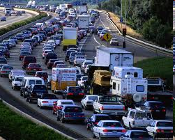
Queueing delay (revisited)
R: link bandwidth (bps)
L: packet length (bits)
a: average packet arrival rate
average queueing delay
traffic intensity
= La/R
La/R ~ 0: avg. queueing delay small
La/R -> 1: avg. queueing delay large
La/R > 1: more “work” arriving
than can be serviced, average delay infinite!
La/R ~ 0
* Check out the Java applet for an interactive animation on queuing and loss
La/R -> 1
Introduction
1-<number>

Slide 13
What is the difference between transmission and propagation delay?
Transmission delay has to do with link bandwidth and congestion, whereas propagation delay concerns the length of the link times the bandwidth.
Transmission delay has to do with link bandwidth and congestion, whereas propagation delay concerns the propagation speed in the link.
Transmission delay has to do with packet length and link bandwidth, whereas propagation delay concerns the length of the link and the speed in the link.
Transmission delay has to do with packet length and link bandwidth, whereas propagation delay concerns the length of the link and the link bandwidth.
1-<number>

Slide 14
Ασκηση 6
Θεωρήστε δύο υπολογιστές Α και Β συνδεδεμένους με μία ζεύξη ρυθμού R bps. Υποθέστε ότι οι δύο υπολογιστές απέχουν m μέτρα και η ταχύτητα διάδοσης επάνω στη ζεύξη είναι s m/s.Ο υπολογιστής Α στέλνει ένα πακέτο μεξγέθους L bits στο Β.
a) Ποια είναι η καθυστέρηση διάδοσης dprop
b) Ποια είναι η καθυστέρηση μετάδοσης dtrans
c) Αγνοώντας καθυστερήσεις επεξεργασίας και αναμονής, βρείτε μια έκφραση για την καθυστέρηση από άκρο σε άκρο
Introduction
2-<number>

Slide 15
Ασκηση 6
d) Υποθέστε ότι ο υπολογιστής Α αρχίζει να μεταδίδει το πακέτο σε χρόνο τ=0. Στο χρόνο τ= dtrans που βρίσκεται το τελευταίο bit του πακέτου;
e) Υποθέστε ότι το dprop είναι μεγαλύτερο του dtrans. Σε χρόνο τ= dtrans πού βρίσκεται το πρώτο bit του πακέτου;
f) Υποθέστε ότι το dprop είναι μικρότερο του dtrans. Σε χρόνο τ= dtrans πού βρίσκεται το πρώτο bit του πακέτου;
g) Υποθέστε ότι s=2.5 * 10^8, L= 120 bits, R=56 kbps.Βρείτε την απόσταση ώστε dprop = dtrans
Introduction
2-<number>

Slide 16
“Real” Internet delays and routes
what do “real” Internet delay & loss look like?
traceroute program: provides delay measurement from source to router along end-end Internet path towards destination. For all i:
  sends three packets that will reach router i on path towards destination
  router i will return packets to sender
  sender times interval between transmission and reply.
3 probes
3 probes
3 probes
Introduction
1-<number>

Slide 17
“Real” Internet delays, routes
traceroute: gaia.cs.umass.edu to www.eurecom.fr
3 delay measurements from
gaia.cs.umass.edu to cs-gw.cs.umass.edu
1 cs-gw (128.119.240.254) 1 ms 1 ms 2 ms
2 border1-rt-fa5-1-0.gw.umass.edu (128.119.3.145) 1 ms 1 ms 2 ms
3 cht-vbns.gw.umass.edu (128.119.3.130) 6 ms 5 ms 5 ms
4 jn1-at1-0-0-19.wor.vbns.net (204.147.132.129) 16 ms 11 ms 13 ms
5 jn1-so7-0-0-0.wae.vbns.net (204.147.136.136) 21 ms 18 ms 18 ms
6 abilene-vbns.abilene.ucaid.edu (198.32.11.9) 22 ms 18 ms 22 ms
7 nycm-wash.abilene.ucaid.edu (198.32.8.46) 22 ms 22 ms 22 ms
8 62.40.103.253 (62.40.103.253) 104 ms 109 ms 106 ms
9 de2-1.de1.de.geant.net (62.40.96.129) 109 ms 102 ms 104 ms
10 de.fr1.fr.geant.net (62.40.96.50) 113 ms 121 ms 114 ms
11 renater-gw.fr1.fr.geant.net (62.40.103.54) 112 ms 114 ms 112 ms
12 nio-n2.cssi.renater.fr (193.51.206.13) 111 ms 114 ms 116 ms
13 nice.cssi.renater.fr (195.220.98.102) 123 ms 125 ms 124 ms
14 r3t2-nice.cssi.renater.fr (195.220.98.110) 126 ms 126 ms 124 ms
15 eurecom-valbonne.r3t2.ft.net (193.48.50.54) 135 ms 128 ms 133 ms
16 194.214.211.25 (194.214.211.25) 126 ms 128 ms 126 ms
17 * * *
18 * * *
19 fantasia.eurecom.fr (193.55.113.142) 132 ms 128 ms 136 ms
trans-oceanic
link
* means no response (probe lost, router not replying)
* Do some traceroutes from exotic countries at www.traceroute.org
Introduction
1-<number>

Slide 18
Packet loss
queue (aka buffer) preceding link in buffer has finite capacity
packet arriving to full queue dropped (aka lost)
lost packet may be retransmitted by previous node, by source end system, or not at all
buffer
(waiting area)
A
packet being transmitted
B
packet arriving to
full buffer is lost
* Check out the Java applet for an interactive animation on queuing and loss
Introduction
1-<number>

Slide 19
Throughput
throughput: rate (bits/time unit) at which bits transferred between sender/receiver
  instantaneous: rate at given point in time
  average: rate over longer period of time
server, with
file of F bits
to send to client
link capacity
R_{s} bits/sec
link capacity
R_{c} bits/sec
server sends bits
(fluid) into pipe
pipe that can carry
fluid at rate
R_{s} bits/sec)
pipe that can carry
fluid at rate
R_{c} bits/sec)
Introduction
1-<number>

Slide 20
Throughput (more)
R_{s} < R_{c} What is average end-end throughput?
R_{s} bits/sec
R_{c} bits/sec
R_{s} > R_{c} What is average end-end throughput?
R_{s} bits/sec
R_{c} bits/sec
bottleneck link
link on end-end path that constrains end-end throughput
Introduction
1-<number>

Slide 21
Throughput: Internet scenario
per-connection end-end throughput: min(R_{c},R_{s},R/10)
in practice: R_{c} or R_{s} is often bottleneck
R_{s}
R_{s}
R_{s}
R
R_{c}
R_{c}
R_{c}
10 connections (fairly) share backbone bottleneck link R bits/sec
Introduction
1-<number>

Slide 22
Quiz
What is needed for two computers to communicate?
➔ Θα το συζητήσουμε στην αρχή τις επόμενης διάλεξης
Introduction
1-<number>

